Slide 1

Multiple Regression Analysis: Atmospheric CO2 Concentration
Edwin Aguirre, Maruthi Kumar, Gregory Cameron, Atlanta Liu
Data 604: Statistical Modelling with Data

Slide 2

Introduction & Data Sources
Global Atmospheric CO2 Concentration
Our World in Data
Projected Datasets

Slide 3


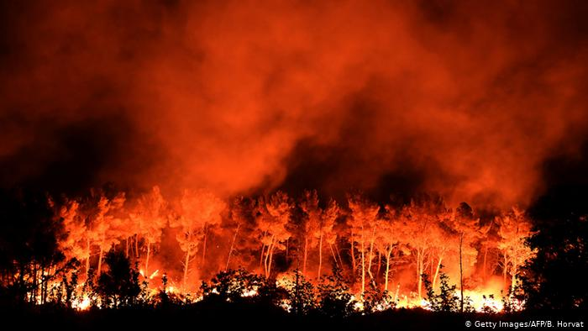
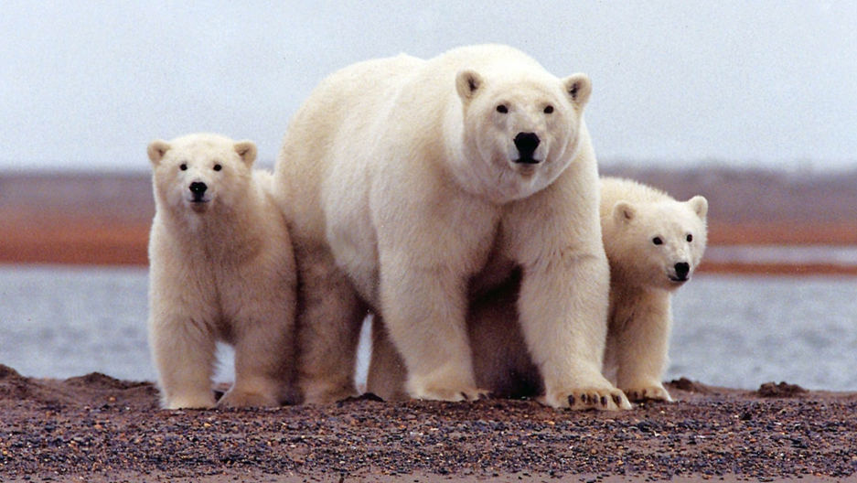

Slide 4

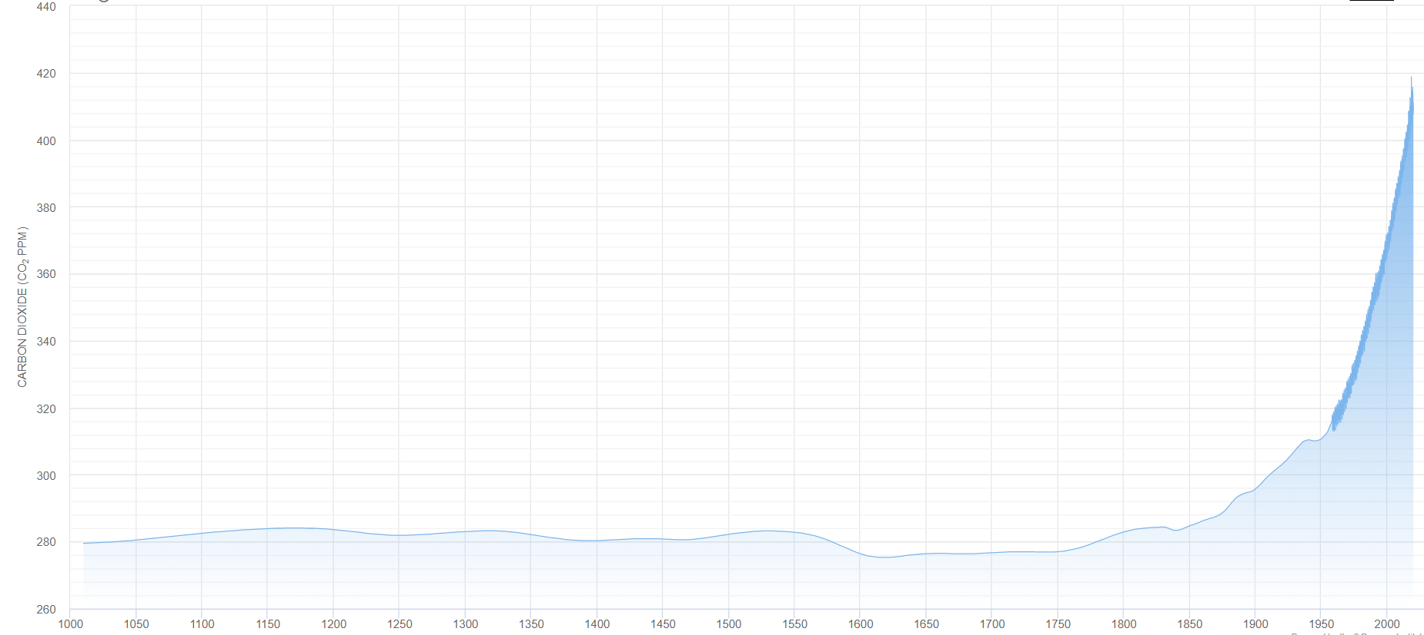

Global Atmospheric CO2 Concentration
440ppm
$${CO}_{2 }$$
260ppm
1000
Year
2019

Slide 5
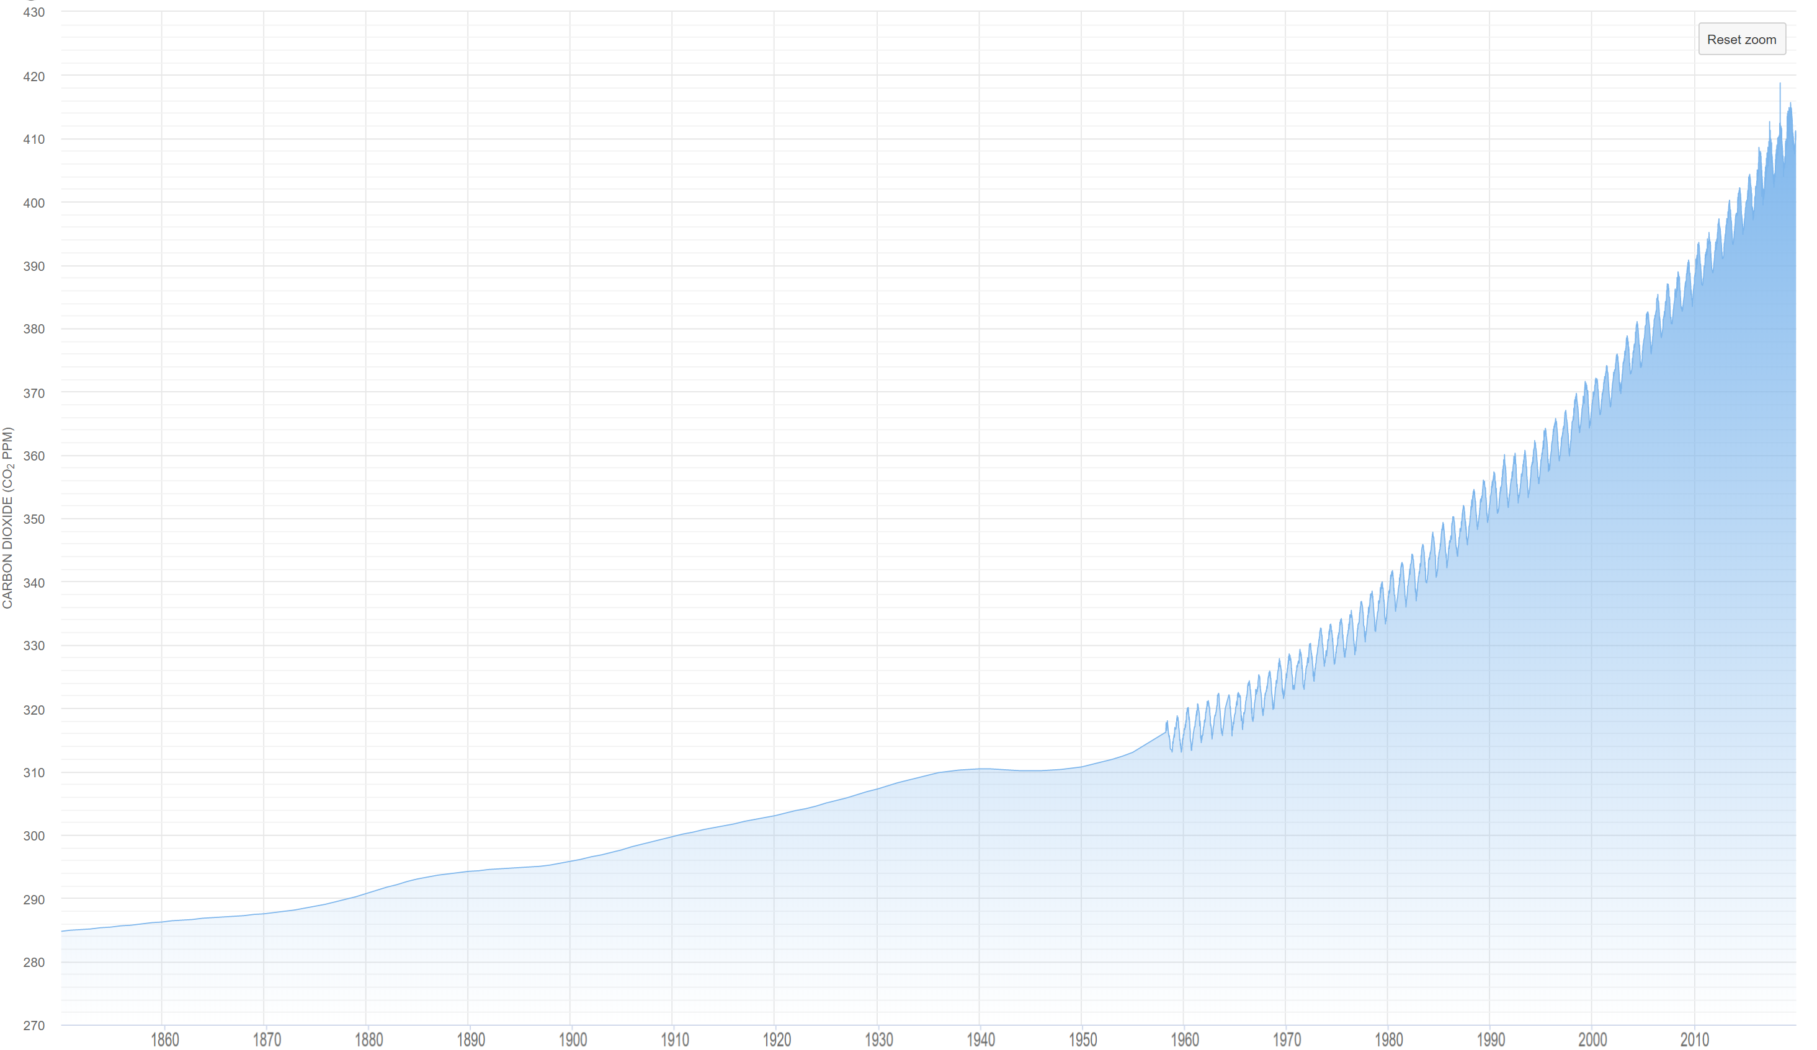
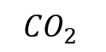
Global Atmospheric CO2 Concentration: 1850 – Present
430ppm
$${CO}_{2 }$$
270ppm
1850
Year
2019

Slide 6
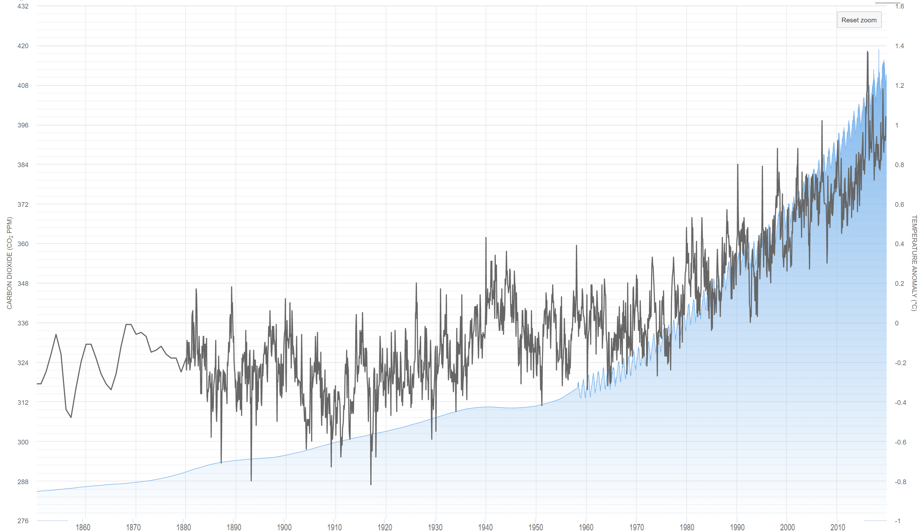
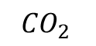
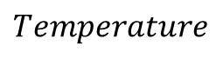
Global Atmospheric CO2 Concentration + Temperature: 1850 – Present
432ppm
1.6 ºC
$${CO}_{2 }$$
$$Temperature$$
276ppm
-1.0 ºC
1850
Year
2019

Slide 7
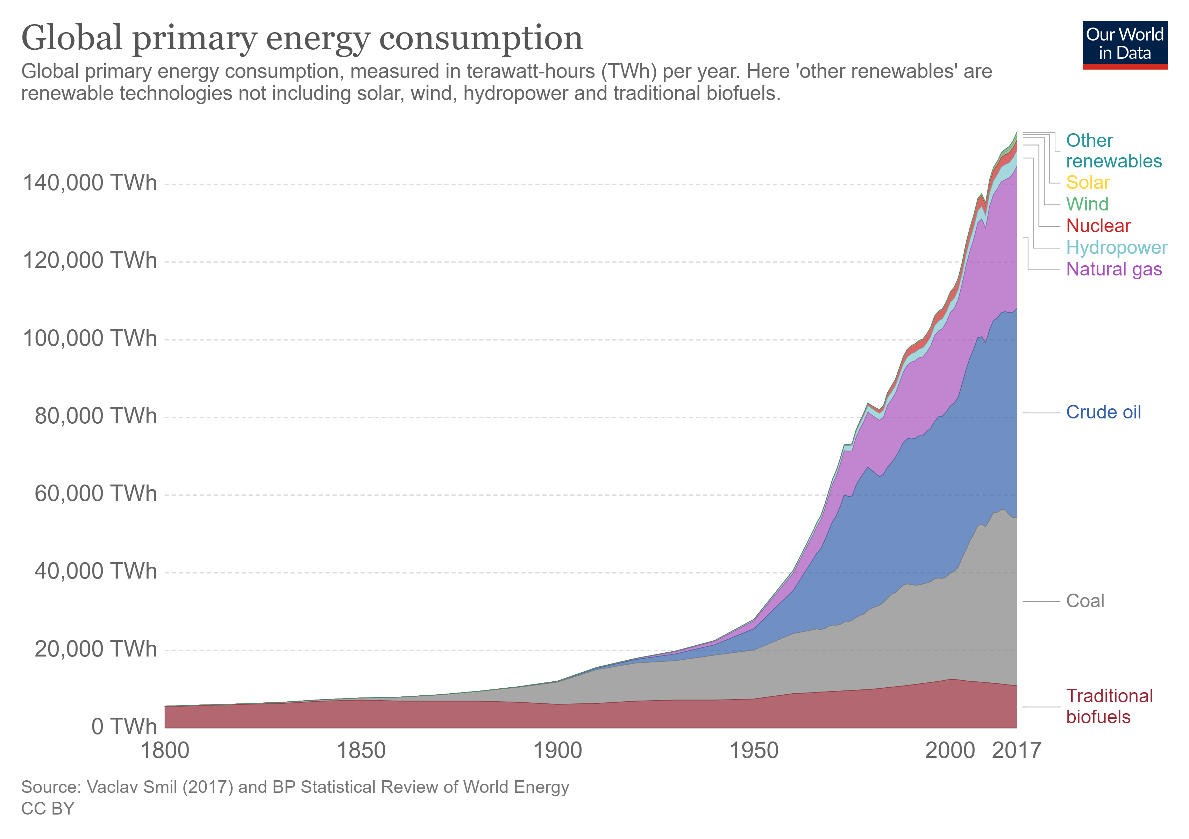
Our World in Data

Slide 8
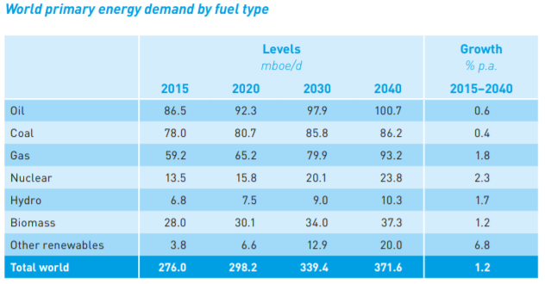
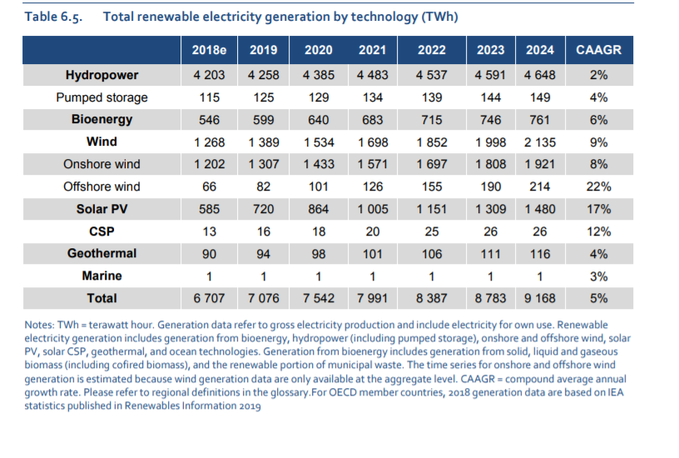
Datasets for Projection
World Oil Outlook 2040
IEA Renewables 2019

Slide 9
Variables Description + Modelling Procedure
Sequential Independent Variable Removal
Main Effect Model
Main Effect + Interaction term Model
Main Effect + High Order term Model
F-Test
Best Fit Model

Slide 10
Dependent and Independent Variables
CO2 - Atmospheric CO2 measurement (parts per million (ppm)) =Dependent variable
Coal - Coal Consumption (Terawatt Hour (TWh)) =Independent Variable
Oil - Oil Consumption (Terawatt Hour (TWh)) =Independent Variable
Gas - Natural Gas Consumption (Terawatt Hour (TWh)) =Independent Variable
Hydropower - Hydro-Electricity Generation (Terawatt Hour (TWh)) =Independent Variable
Wind - Wind Electricity Generation (Terawatt Hour (TWh)) =Independent Variable
Solar - Solar Electricity Generation (Terawatt Hour (TWh)) =Independent Variable
Year - Year of measurement (Year) =Independent Variable
Other Renewables - Other sources of renewable energy, including modern biofuels, geothermal, wave and tidal (Terawatt Hour (TWh)) =Independent Variable
Population - Global Population (people) =Independent Variable
GDP per Capita - Global GDP per Capita (2011 USD) =Independent Variable

Slide 11
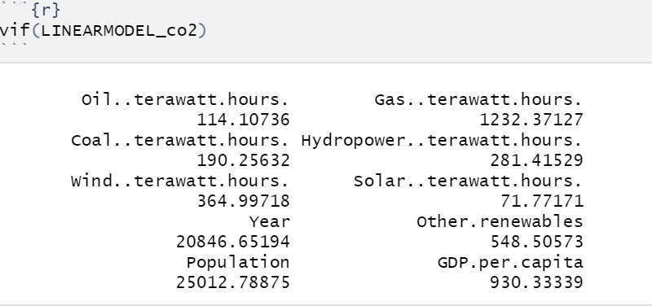
Modelling Plan:
Therefore, the original multiple regression model is given by :
However, one can observe that the main independent variables have High Multicollinearity:

Slide 12
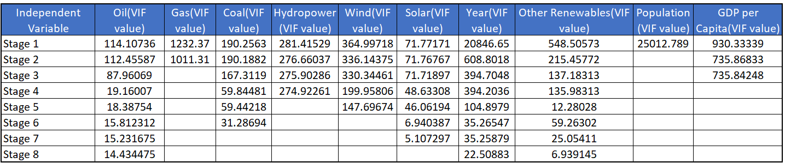
Sequential Independent Variable Removal
Independent Variable Removed = Population
Independent Variable Removed = Gas
Independent Variable Removed = GDP per Capita
Independent Variable Removed = Hydropower
Independent Variable Removed =Wind
Independent Variable Removed =Coal
Independent Variable Removed =Solar

Slide 13
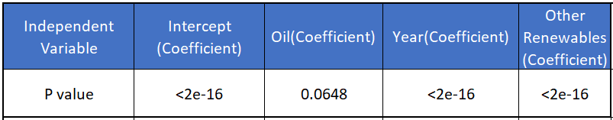
Main Effect Model
Main Effect +Interaction Model

Slide 14
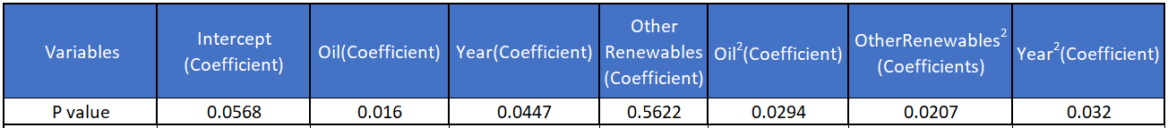
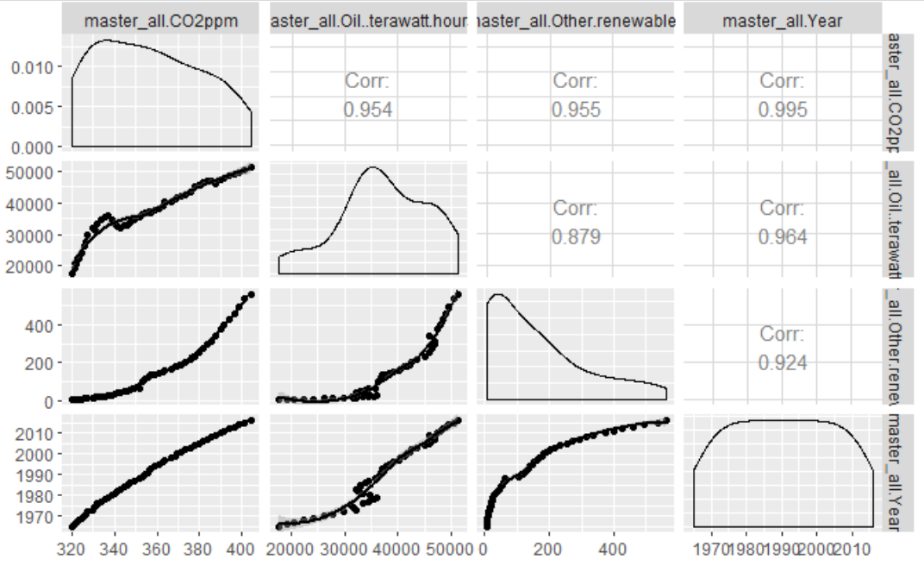
Main Effect + High Order terms Model

Slide 15
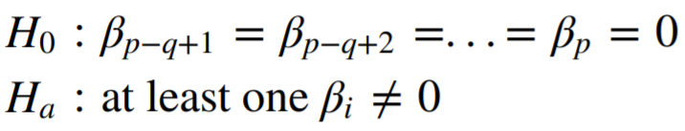
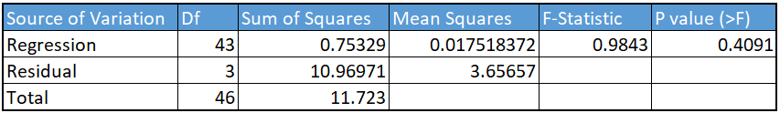
Main Effect + Interaction + Higher order terms Model
All coefficients became insignificant, therefore a Partial F-test was conducted, in which the Full model included main+ interaction + higher order terms, while the Reduced model included the main + interaction terms.
The results are :

Slide 16
Best Fit Model
Where:
B₀ = 3.32*10⁻¹⁶
B_{Oil} = 1.66*10⁻⁰⁷
B_{Year} = 2.0*10⁻¹⁶
B_{OtherRenewables} = 0.02073
B_{Oil*Year} =2.13*10⁻⁰⁷
B_{Oil*OtherRenewables} = 0.00155

Slide 17
Final Model and Interpretations
Final Model
Assumptions
Coefficient Interpretations

Slide 18
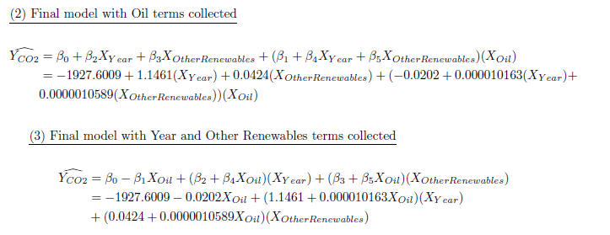
Final Model
R²_{adj} = 0.9996
RMSE = 0.5048

Slide 19
Model Assumptions:
1. Linearity Assumption - Review residual plots
2. Independence Assumption - Review residual against year (time)
3. Normality Assumption - Using Shapiro-Wilk normality test
4. Equal Variance Assumption - Using Breusch-Pagan test
5. Multicollinearity - Using variance inflation factors (VIF)
6. Outliers - check Cook's distance and leverage

Slide 20
Normality Assumption

Slide 21
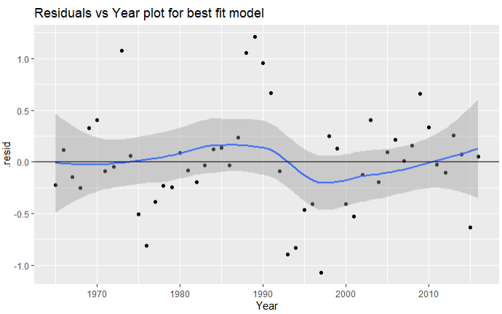
Independence Assumption

Slide 22
Outliers

Slide 23
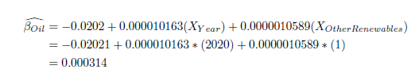
Interpreting Coefficients: Oil
There are a total of three β_{i} (i = Oil, Year, Other Renewables) coefficients in our final model. These are interpreted below in relation to atmospheric CO₂ concentration levels.
Which means that the effect of Oil consumption on CO₂ concentration in the atmosphere changes by year and amount of other renewables energy consumption.
For year 2020, when other renewables consumption is 1 terawatt-hour, then increasing Oil consumption by 1 terawatt-hour leads to an increase in CO₂ presence in atmosphere by 0.000314 ppm.

Slide 24
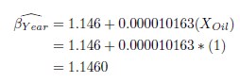
Interpreting Coefficients: Year
This value suggests that the effect of year on CO₂ presence in the atmosphere (in ppm) changes by Oil consumption.
Which means, when other renewables consumption is held constant and Oil consumption is 1 terawatt-hour, then every subsequent Year leads to an increase in CO₂ presence in atmosphere by 1.1460 ppm.

Slide 25
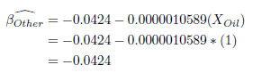
Interpreting Coefficients: Other Renewables
This value suggests that the effect of other renewables consumption on CO2 presence in the atmosphere (in ppm) changes by Oil consumption.
Which means, when Year is held constant and Oil consumption is 1 terawatt-hour, then increasing other renewable consumption by 1 terawatt-hour leads to a decrease in CO2 presence in atmosphere by 0.04241 ppm

Slide 26
Discussion & Conclusion
Predictions
Multicollinearity
Future Works

Slide 27
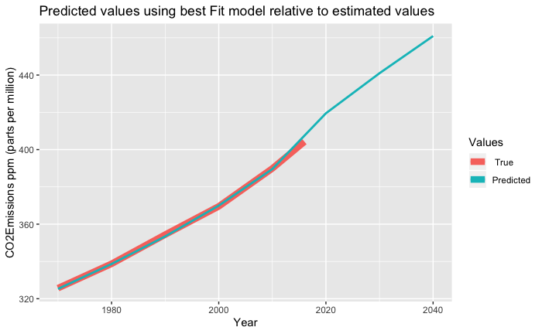
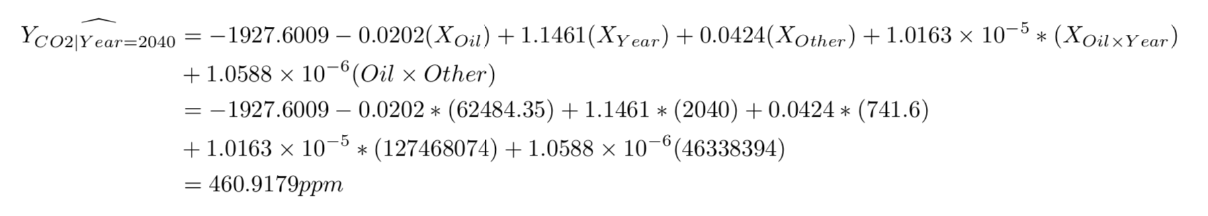
Predictions
Predictions from our best fitted model
10-year increments
Closely matches historic measurements
Prediction results
Atmospheric CO2 will cross 450 ppm threshold in mid 2030s
Atmospheric CO2 level (ppm)
Measured
Predicted

Slide 28
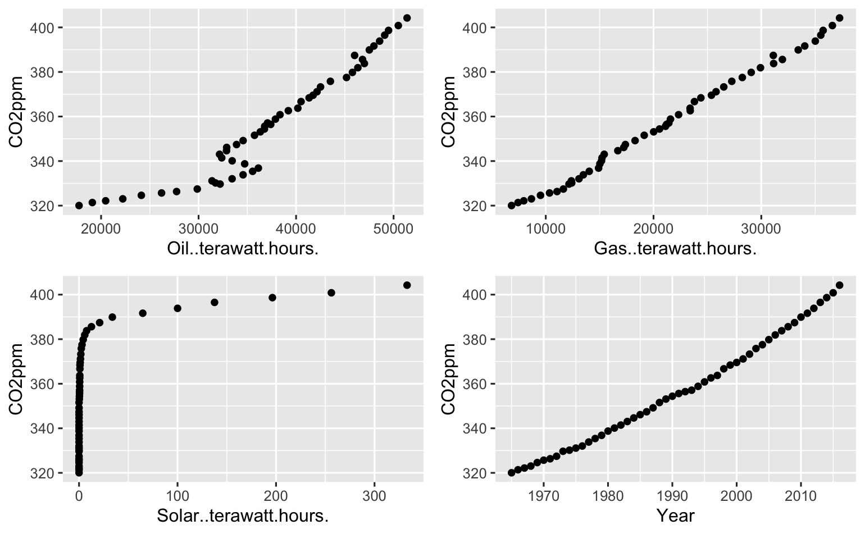
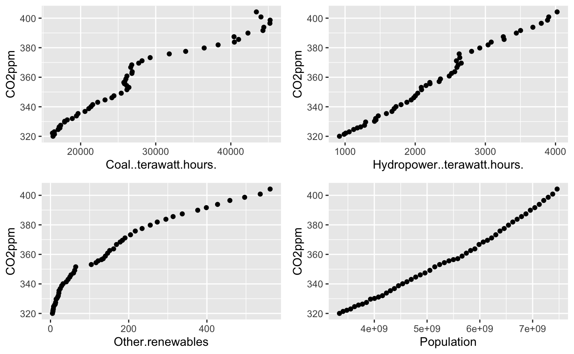
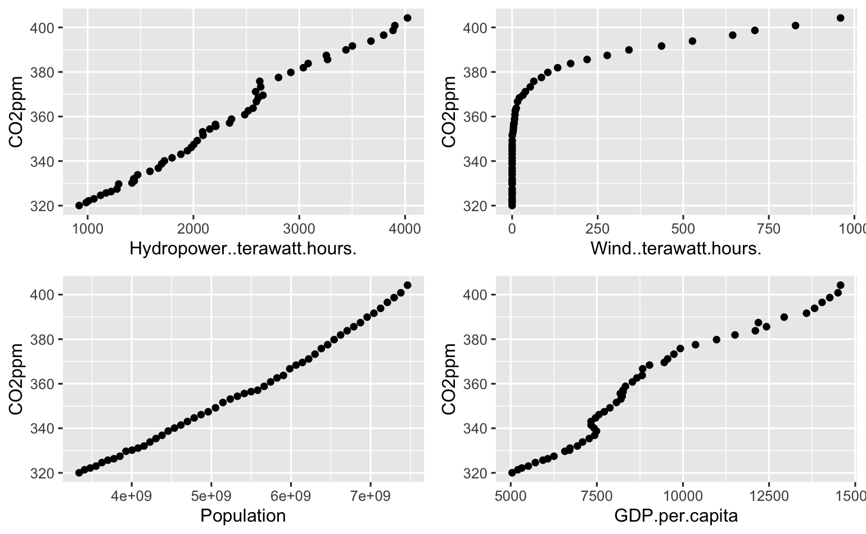
Multicollinearity time-series data
Single variable model
R2adj = 0.99!

Slide 29
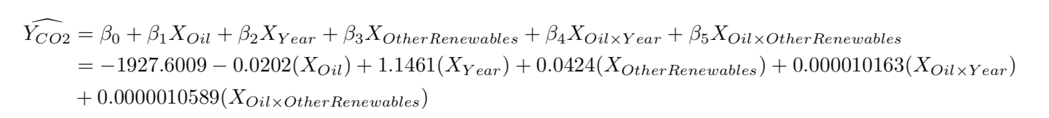
Conclusion and Future Work
High multicollinearity between independent variables due to time-series
Unstable p-values
Stepwise regression did not work
Used VIF values for variable selection
Final model:
Further work – use time-series method
More stable model?
More useful predictions?

Slide 30
Questions?

